Slide 1

Devops course
SQL vs. NoSQL Databases

Slide 2
SQL Database Issues
● Scalability
● Flexibility

Slide 3
Scalability
The ability of a system to handle a growing amount of work in a capable manner or its ability to be enlarged to accommodate that growth.

Slide 4
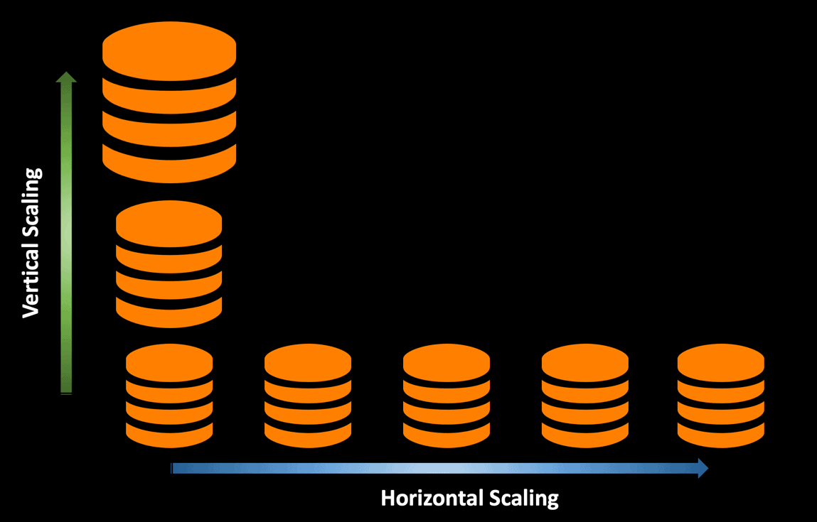
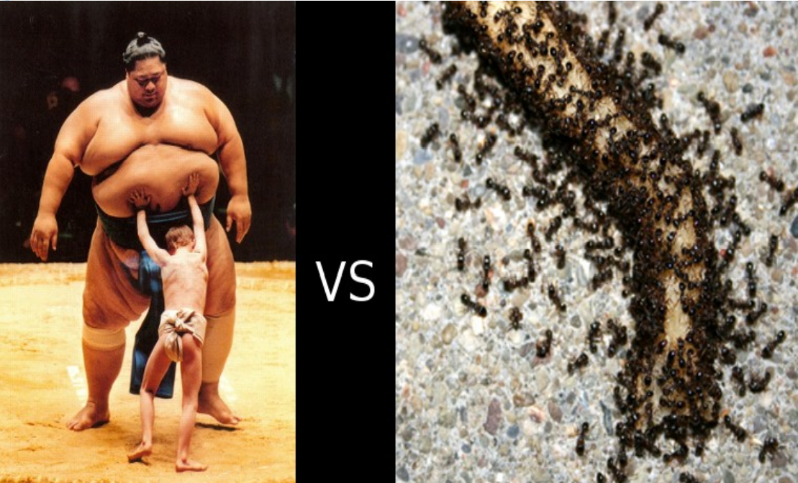
Scalability Types
Vertical
Horizontal

Slide 5
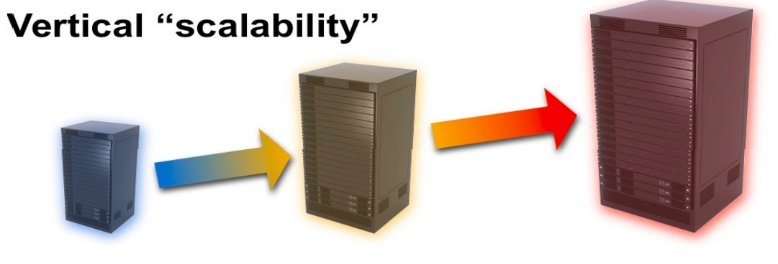
SQL Dbs are Vertically Scalable
✔ Low performance
✔ Lots of engineering work
✔ Expensive

Slide 6
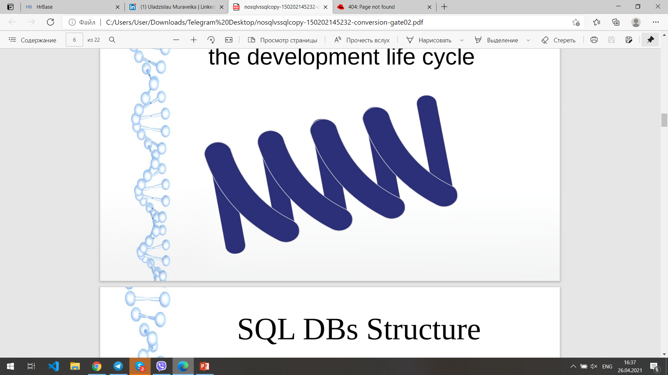
Flexibility
The ability of a system to change during the development life cycle

Slide 7
SQL DBs Structure
✔ Change of the data structure is difficult and costly
✔ Not suitable for model software methodologies, e.g. agile.

Slide 8
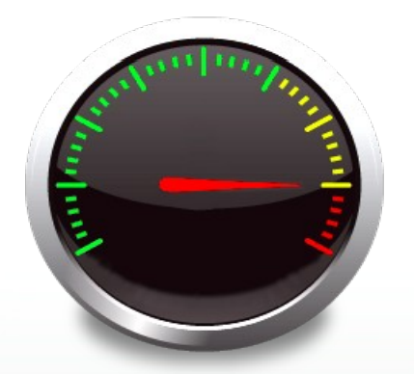
Performance
The capabilities of a system when observed under particular conditions

Slide 9
SQL DBs are Relational DBs
✔ Cross-table queries are inevitable
✔ Multiple queries on different tables hurts the performance
✔ No direct mapping between tables in a database and objects in an OOL

Slide 10
NoSQL Databases
Not Only SQL :)

Slide 11
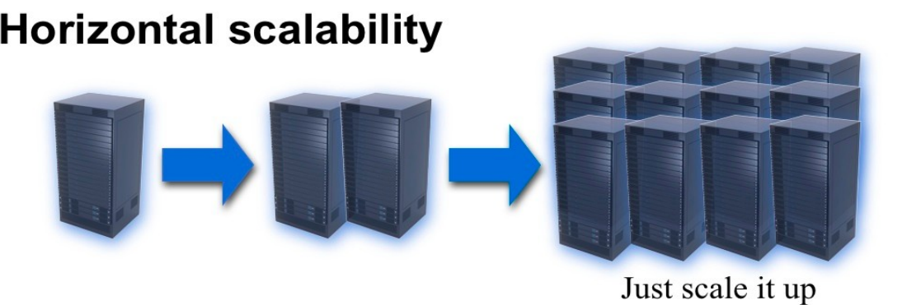
Scalability
➔ Auto Sharding

Slide 12
Flexibility
✔ Schema-free Database
✔ Suitable for the rapid application development

Slide 13
Performance
✔ No cross-collection queries
✔ Data is manipulated through OO APIs

Slide 14
NoSQL Database Types
✔ Document Databases
✔ MongoDB
✔ Graph Stores
✔ Key-value Stores
✔ Wide-column stores

Slide 15
MongoDB High Performance
✔Easily Scalable
✔ Document-based
✔ NoSQL
✔BSON formatted Data
✔Queried through Idiomatic Drivers

Slide 16
MongoDB
Account Holders
ID | First_Name | Last_Name
0 | Osama | Steve
1 | Jomaa | Brightwood
Accounts
ID | Account_Type | Account_Balance | Currency | Holder (FK: Persons)
0 | Investement | 80000.00 | USD | 0
1 | Investement | 70400.00 | USD | 0
2 | Checking | 4500.00 | USD | 0
3 | Checking | 4500.00 | YEN | 1
4 | Investement | 5000.00 | YEN | 1
5 | Investement | 6000.00 | YEN | 1

Slide 17
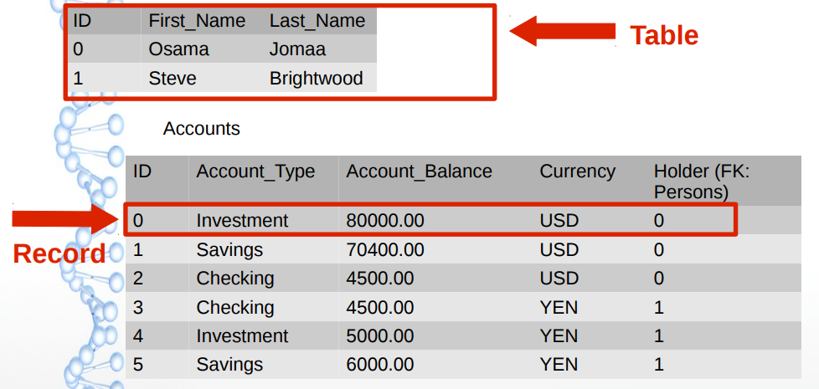
MongoDB

Slide 18
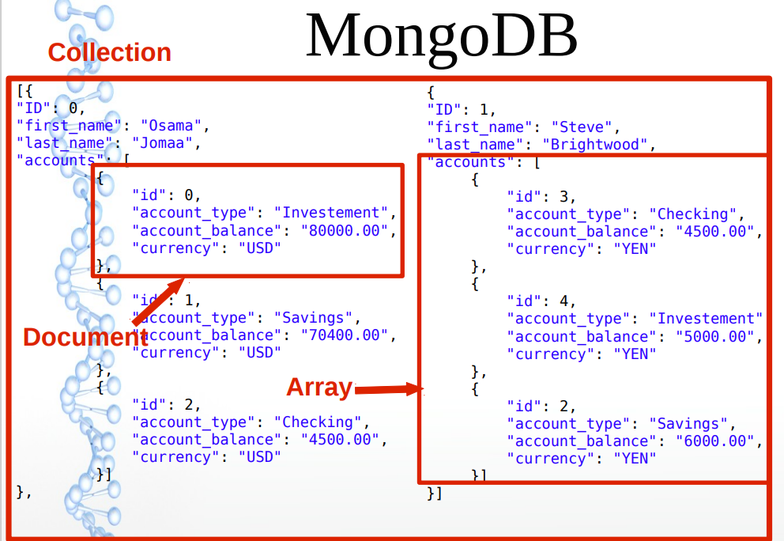
MongoDB

Slide 19
Our DB: Paper
{
“PMID” : The pubmed id for the paper
“Organism” : The organism that the paper studies
“Citation” : The list of citations of the paper
“MeshHeadings” : The list of the MeSH headings that the paper is annotated to
“PubTypes” : The list of publication types for this paper
“Proteins”: The list of proteins studied in the paper
}

Slide 20
Our DB: Protein
{
“PID”: Protein ID,
“Organism”: The organism of the protein
“Sequence”: The amino acid sequence of the protein
“GO Terms”: The Gene Ontology terms that the proteins is annotated to
“Papers”: The list of papers that the protein is studied in
“Homologs”: The homologs of the protein acquired by BLAST
}

Slide 21
Our DB: MeSH Tree
{
“TID”: Term ID “Category”: One of the 16 MeSH top level categories
“Parent”: The direct MeSH parent of the term
“Ancestors”: The list of the term MeSH ancestors
}

